Slide 1
Real-Time Analytics with NewSQL: Why Hadoop is not enough
Raj Bains
Director of Product Management

Slide 2
Agenda
SQL on Hadoop
NewSQL with customer examples
When to use which Technology
NewSQL compared
Operations – the big problem with big data

Slide 3



Scale-out: The Architecture of the Cloud
NoSQL
NewSQL
Scale-out SQL
SQL
Warehouses
Hadoop
High Volume Simple Transactions
System-of-Record
Transactions
Real-Time Analytics
Fast Analytics
on old data
Batch Analytics
on Massive Data Sets

Slide 4
What goes around, comes around…
SQL is cool again!!
Batch jobs via Map Reduce
Apache Hive
✓ Fault Tolerance
✓ Scales to Petabytes
✓ Schema Flexibility
Real-time query response
On Data Warehouse
Cloudera Impala
Apache
Drill (MapR)
Presto (Facebook)
Shark/Spark (UC Berkeley AMPLab)
Stinger initiative and Tez (Hortonworks)
IBM Big SQL
Pivotal HAWQ
? Fault Tolerance
? Scale to Petabytes
? Schema Flexibility
Transactional Database on Hbase?
Unproven

Slide 5
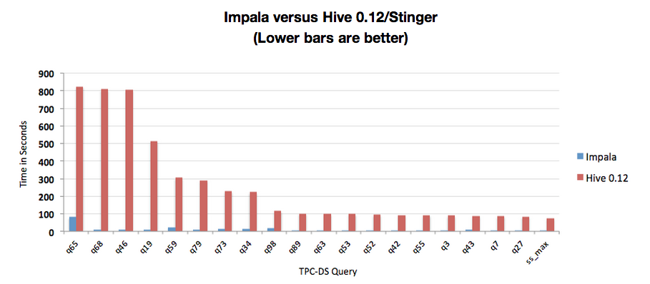
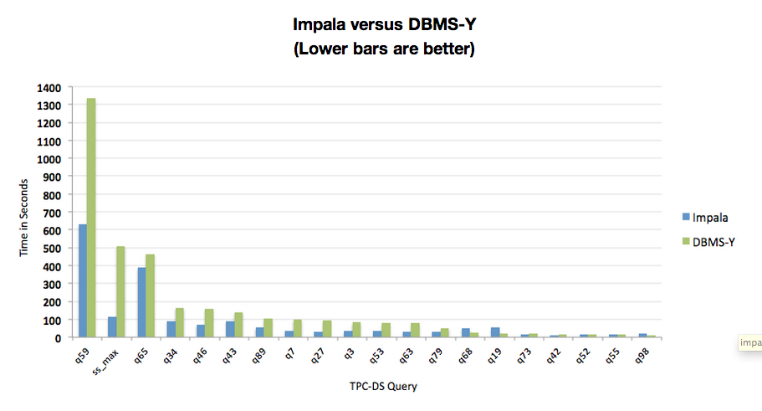
Example: Cloudera Impala Performance
Impala Performance Update: Now Reaching DBMS-Class Speed
http://blog.cloudera.com/blog/2014/01/impala-performance-dbms-class-speed/
Impala with columnar storage (Parquet) beat Hive (not saying much)
and reaches other columnar stores in performance on TPC-DS
TPC Benchmark™DS (TPC-DS): The New Decision Support Benchmark Standard Examine large volumes of data
Give answers to real-world business questions
Execute queries of various operational requirements and complexities (e.g., ad-hoc, reporting, iterative OLAP, data mining)
Are characterized by high CPU and IO load
Are periodically synchronized with source OLTP databases through database maintenance functions

Slide 6
NewSQL Promise: Scale-out SQL operational database
NewSQL Basics
Operational databases
Scale-out of NoSQL
ACID properties
Distributed Transactions
NewSQL Add-ons
Real-time Analytics
In-Memory
Geo-Distribution
Online schema changes
GOOGLE F1
“We believe it is better to have application programmers deal with performance problems due to overuse of transactions as bottlenecks arise, rather than always coding around the lack of transactions.”
Google is encouraging developers to switch to SQL “for low-latency OLTP queries, large OLAP queries, and everything in between.”

Slide 7



ClustrixDB Introduction
HIGH-SCALE
TRANSACTIONS
REAL-TIME
ANALYTICS
Linear scalability for writes/updates/reads
Double nodes ➔ double transactions/sec
Linear speedup for analytics
Double nodes ➔ half the query time
REAL WORKLOADS
SCALE-OUT
SELF-MANAGING
BUILT-IN FAULT TOLERANCE
Add nodes as demand grows
ACID, SQL AND MYSQL
Notes:
This slide conveys what we believe are the key characteristics of the ideal database for real world workloads and the Cloud. In other words, this is the “wish list” for the ideal database.
Key points to emphasize
Scale-Out SQL is the way to go
Clustrix offers a scale-out SQL database that lets you simply add more nodes* to your cluster as demand grows so you can serve more users, transactions and data.
High-Scale Transactions
Clustrix delivers high transactional query throughput with near linear scale at virtually any data set size and concurrency for all real-world query workloads.
Real-time Analytics
You can run analytic queries against your main database (while running transactions) to get real-time insights and operational intelligence. Clustrix uses Massively Parallel Processing (MPP) that uses multiple cores across nodes in parallel to speed up your analytic queries.
SQL, MySQL and ACID
With Clustrix, you get ACID guarantees and the full power of a SQL interface. Our database is on the wire compatible with MySQL, which means that you can use your existing application code and connectors with Clustrix.
Self-healing
Clustrix is easy to install and automates fault tolerance. Clustrix is built to be self-managing and simplifies operations allowing DBAs to focus on high value add tasks, greating reducing the ownership cost.
Customer Proven
Clustrix has been serving production workloads since 2008. We power dozens of large-scale production customers all around the world. Our largest customers have datasets with billions of rows, multiple terabytes of data, and non-trivial transactional workloads approaching 100,000 TPS in production.
Superior Service
Clustrix provides services that out customers love. Our DBA-on-demand service provides deep technical insight. Managed services in DBaaS monitors your database to find issues before you do.

Slide 8
Clustrix Design
Intelligent Data
Distribution
Massively Parallel
Query Processing
SQL
SQL
SQL
SQL
SQL
Shared
Nothing
Architecture
Query
Compiler
Data map
Query
Compiler
Data map
Query
Compiler
Data map
Database Engine
Database Engine
Database Engine
Notes:
Simple queries
Fielded by any node
Routed to data node
Complex queries
Split into query fragments
Process fragments in parallel

Slide 9

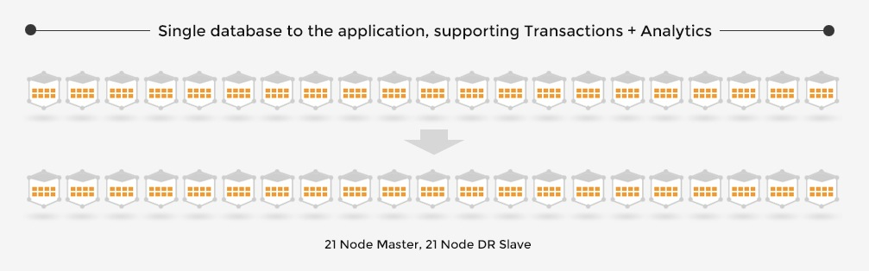
Scaling SQL to 29+ Million users, without a DBA
The Application Social Discovery (dating) and match making
Users | 29+ million
Login | 10 million a day
User Messages | 15 million a day
Likes | 4 million a day
Frequent complex query in the application 7-way join looking with group by and sort
“We have not run into scaling issues anymore. As we’ve need capacity we just add nodes and see linear growth.
Nicolas Van Eenaeme
CIO MassiveMedia
The Database
Transactions | 4.4 Billion a day
Avg. Latency | 5-10 millisec
Cores | 168 x 2
Memory | 1 TB x 2
SSD | 23 TB x 2
Raw reads / writes | 4.69 / 1.08 Petabytes a month
user
user_cxxxxxxx
(1.9 TB Table)
user_email
user_friends
user
user_blocked
user_photo
user_photo_detail
© 2014
Notes:
Online schema change on user_contactlist, a ~2TB table
Running on ClustrixDB for 3 years

Slide 10


Real-Time Analytics for Ad Exchanges
6.9 Billion ad
impressions a day.
Bids in < 50 millisec
Previous setup
Master
Supply side platforms
www.abcd.com
Master struggling to ingest
high volume data, clickstreams
Complex 15 slave network
with lag and inconsistent data
ad
Ad exchanges
Ad Agencies and DSPs make bidding strategies and
run reports to monitor them
“Reports went from up to
4 hours to 15 seconds,
making customers happy.”
- Ken Kwan, CTO
Demand side platforms
Scale-out cluster with multi-master replication All data is synchronized and live for analytics
Ad Agencies
Advertisers
© 2014

Slide 11
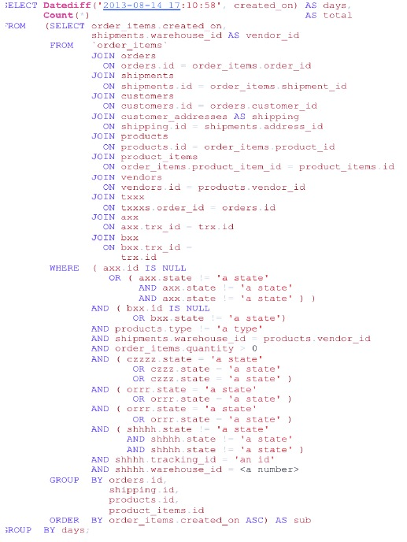

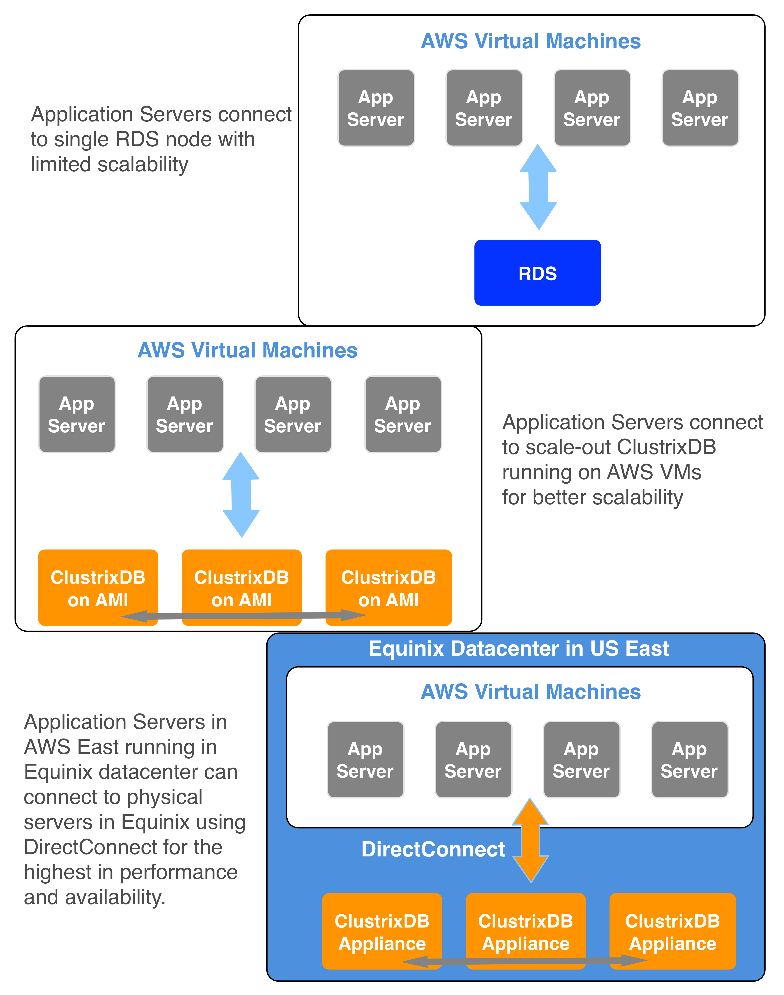
NOMORERACK : Availability and Growth in the Cloud
Cyber Monday: 600% Revenue spike
3x Database Traffic
Scaled from
6 node (48 core) to
14 node (112 core)
Fastest growing e-commerce companies in the US, offering daily deals
1023% growth in revenue
15-20x traffic peaks in the holidays
Complex reporting/analytics queries
© 2014

Slide 12
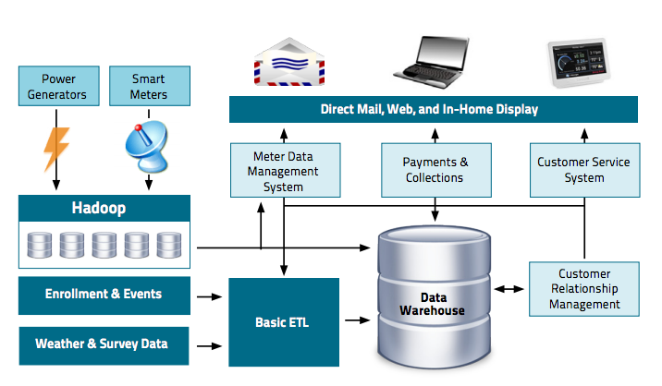
SQL on Hadoop or NewSQL?
HADOOP AND THE DATA WAREHOUSE: When to use which
Dr Amr Awadallah (Cloudera) and Dan Graham (Teradata)
http://www.cloudera.com/content/dam/cloudera/Resources/PDF/Hadoop_and_the_Data_Warehouse_Whitepaper.pdf
Fictional company CostCutter Utilities
10 million households
21.6 billion sensor readings per quarter
Analyze this data together,
in real-time
21.6 billion * 200 bytes = 3.9 Terabytes
NewSQL is a better fit

Slide 13
Architecture with NewSQL for Real-time Analytics
Real-Time Analytics on Live Operational Data
NewSQL
Customer data
Metadata
Users, Files
Commerce data
Machine data
Social data
ETL
Retire
Processed data,
Insights
Hadoop
EDW
Log Data

Slide 14



NewSQL: Scale-out SQL
Transactions (OLTP)
Real-Time Analytics
High Availability
(production)
Geo-distributed OLTP
(production)
Miscellaneous
DBShards
ScaleBase
…
Auto–sharding, storage engines and other tools on top of legacy databases
In-Memory
Real-Time Analytics
(Add-on to production)
In-memory OLTP
ETL for Analytics
(Add-on to production)

Slide 15
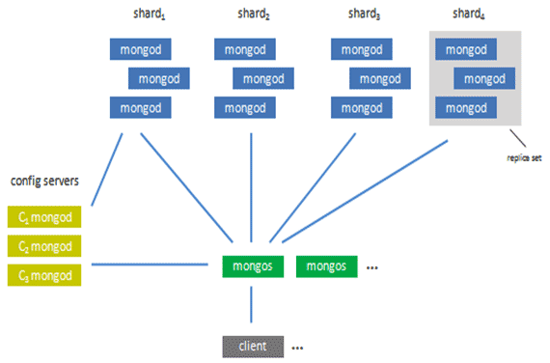
ClustrixDB Horizontal Slicing vs. Sharding
4 active partition configuration
Client or load balancer
No single point of failure by design
Single command to add/remove nodes
Load evenly distributed across cluster on node loss
All copies are consistent – no master-slave lag

Slide 16
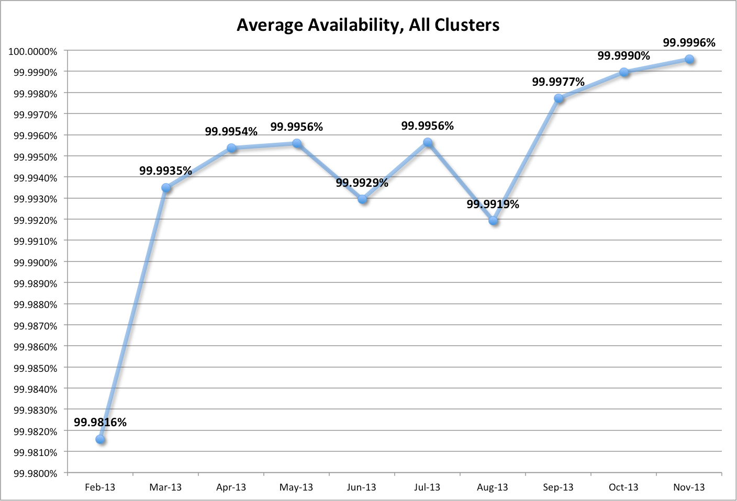
Availability in Production
Is your database production ready??
5 - nines availability is 25 seconds / month
No human intervention – fix bug is possible
Strict Accounting
Any downtime or slow time counted
Database issue or customer process issue

Slide 17
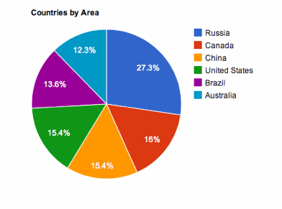
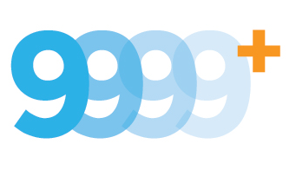
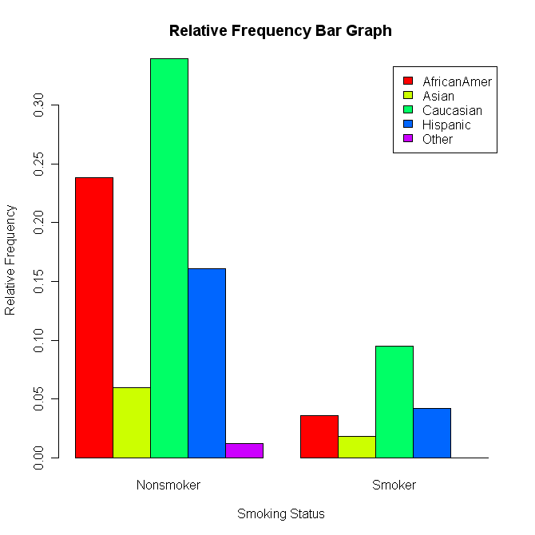
So, NewSQL Scale-out SQL can deliver:
Massive Transactions
volume at low cost
Real-time analytics on real-time data
High availability in the cloud
TRENDS
Fast data ingest
with in-memory
Richer Analytics
More JSON

Slide 18

QUESTIONS

Slide 19
Joins: Data Distribution
Clustrix
Sharding: Co-located indexes
Slicing: Independently distributed indexes
TABLE USERS
id | name | rest
2 | John | …
4 | John | …
6 | Tom | …
TABLE USERS
id | name | rest
3 | John | …
5 | Jake | …
7 | Gopi | …
TABLE USERS
id | name | rest
2 | John | …
4 | John | …
6 | Tom | …
TABLE USERS
id | name | rest
3 | John | …
5 | Jake | …
7 | Gopi | …
INDEX NAME
name | id
John | 2
John | 4
Tom | 6
INDEX NAME
name | id
John | 3
Jake | 5
Gopi | 7
INDEX NAME
name | id
John | 2
John | 4
John | 3
INDEX NAME
name | id
Gopi | 7
Jake | 5
Tom | 6

Slide 20
Joins: In Action
Sharding: Joins are broadcasts
Slicing: Joins are scalable
TABLE PRODUCT
product | name
2 | John
TABLE PRODUCT
product | name
2 | John
???
What Happens for a 10,000 X 100 Join?
Terribly Slow and not scalable
Design Schema based on Joins
Scales
INDEX NAME
name | id
John | 2
John | 4
Tom | 6
INDEX NAME
name | id
Gopi | 7
Jake | 5
John | 3
INDEX NAME
name | id
John | 2
John | 4
John | 3
INDEX NAME
name | id
Gopi | 7
Jake | 5
Tom | 6

Slide 21
NewSQL Revisited: VoltDB
Data Distribution is similar to ClustrixDB
Fast OLTP
In-memory
Reduce Locking and Latching
Analytics
No MVCC – reads will block writes or non-ACID
Plug-and-play compatibility
Java stored procedures
Tool ecosystem
S1
S2
S1
S2

Slide 22
NewSQL Revisited: NuoDB
Focus on OLTP and Geo-distributed OLTP
Transaction
node
Transaction
node
Transaction
node
S2
Data is moved to the node that needs it,
in small pieces
Data is moved back to storage nodes for commit
S1
Data (and ownership) is moved across nodes if other nodes need to use it
Storage
node

Slide 23
NewSQL Revisited: MemSQL
In-Memory with MVCC
Two tier architecture and some restrictions
Leaf nodes are not cluster-aware and hold shards
JSON support
Aggregator
(cluster aware)
Aggregator
(cluster aware)
Data is pulled to aggregator nodes for some queries
Some queries are pushed down to leaf nodes
S1
Leaf node
Leaf node
Leaf node
Leaf node
Availability through DB level master-slaving

